Slide 1

ZAS Robotic Products
Navigational Robotic Series
Robot Car-3 (Advanced Autonomy)
GPS Fix Quality and Accuracy

Slide 2
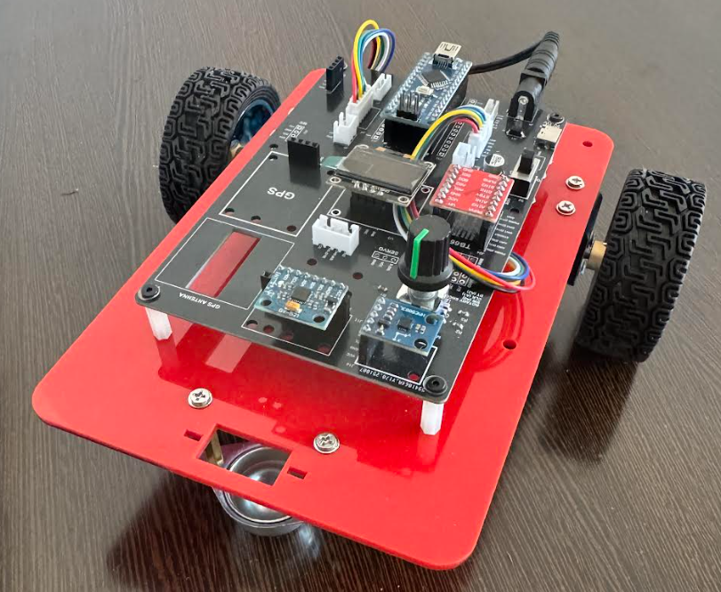
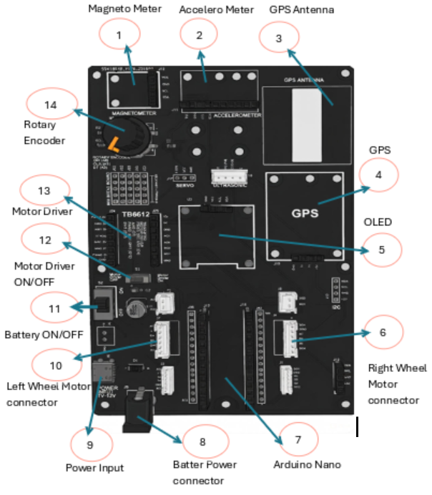
GPS Fix Quality and Accuracy
Robot Car-1 - Assembled view and Creative Board component layout

Slide 3
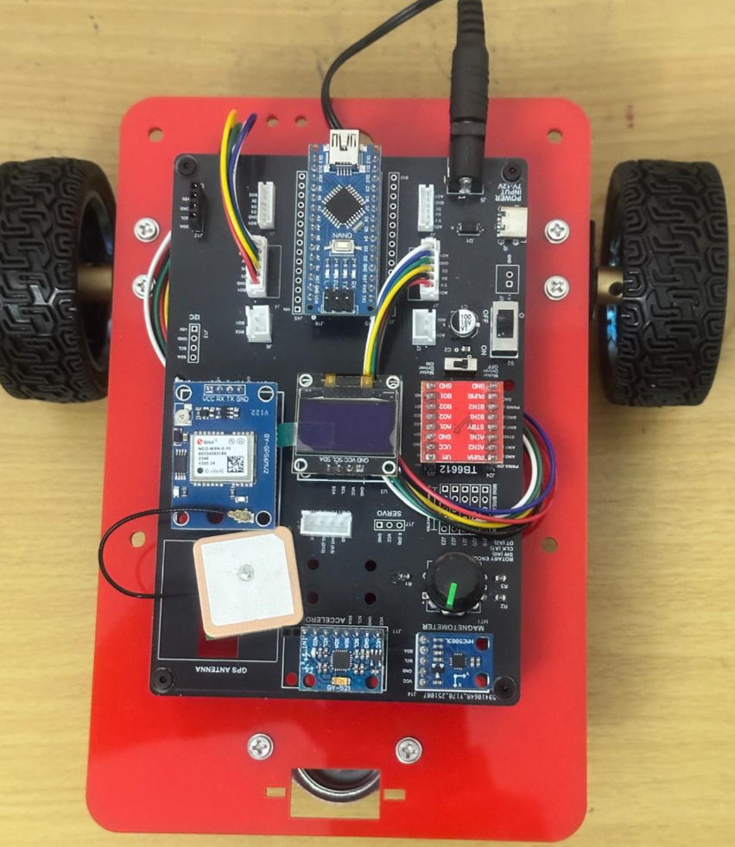
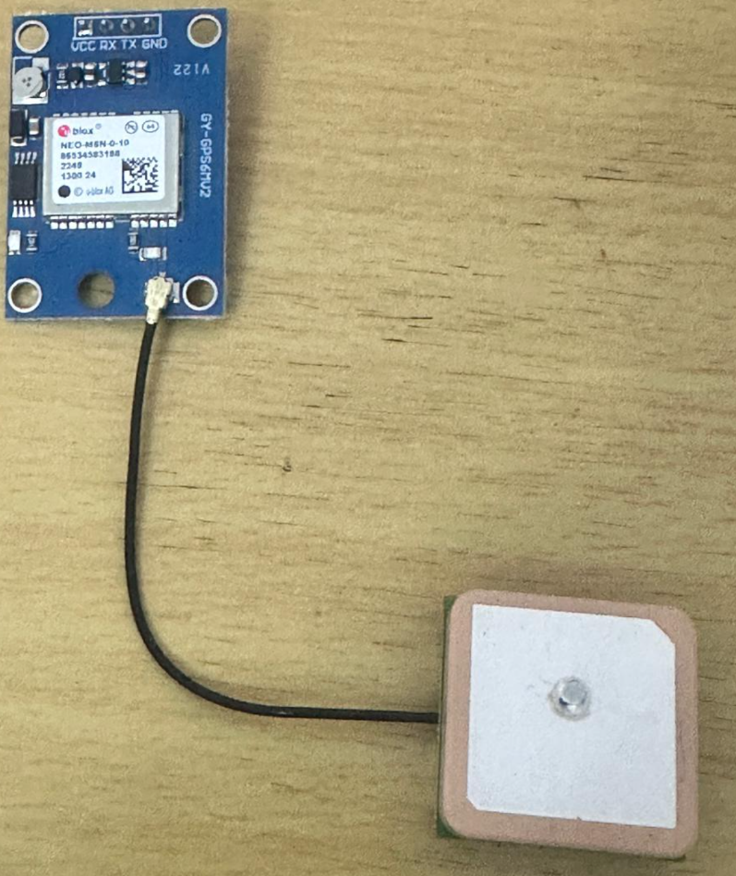
GPS Fix Quality and Accuracy
GPS & GPS Antenna mounter on Robot Car-3

Slide 4
GPS Fix Quality and Accuracy
Purpose of This Experiment
(Mandatory Foundation)
Purpose of this experiment
To examine how GPS reliability is established before positional data is used
To understand the concept of GPS Fix and data freshness
To evaluate whether GPS data is usable at a given moment
To prevent incorrect navigation decisions caused by invalid or stale GPS data
Key idea:
GPS coordinates must not be used unless a valid Fix and fresh data are confirmed.

Slide 5
GPS Fix Quality and Accuracy
Key Definitions
GPS Fix A condition in which the GPS receiver has successfully computed a valid geographical position.
Fix = YES Indicates that latitude and longitude values are valid and usable.
Fix = NO Indicates that the GPS receiver is still searching for sufficient satellite data.
Age (milliseconds) The elapsed time since the last valid GPS location update was received.
Accuracy The reliability of the reported GPS position at a given time.

Slide 6
GPS Fix Quality and Accuracy
Experiment Objectives
Interface a GPS module with Arduino using UART Serial communication
Decode GPS data using the TinyGPS++ library
Determine GPS Fix status
Measure GPS data freshness (Age)
Display Fix, Age, Latitude, and Longitude on an OLED display
Observe real-world behavior such as cold start delay and stability over time

Slide 7
GPS Fix Quality and Accuracy
Learning Outcomes
The meaning and importance of GPS Fix is established
The role of Age in determining data freshness is demonstrated
Conditions under which GPS data is reliable are identified
Correct engineering practice for validating sensor data is reinforced
GPS data validation is applied as a prerequisite for navigation logic

Slide 8
GPS Fix Quality and Accuracy
System Setup
Hardware Used
Arduino Nano (ATmega328P)
GPS Module (UART based)
OLED Display 128×64 (I2C, Address 0x3C)
Robot Car-3 Controller Board
Important Wiring Note
GPS connected to D0 (RX) / D1 (TX)
Disconnect GPS during program upload if required
Do not keep Serial Monitor open during upload
Note:
Cold start time may be 2–5 minutes outdoors.

Slide 9
GPS Fix Quality and Accuracy
Algorithm
Step-by-Step Algorithm
Initialize Serial communication and OLED display
Continuously read incoming GPS serial bytes
Decode GPS data using TinyGPS++
Check whether GPS location is valid (Fix status)
Read Age of the last valid GPS update
Display Fix, Age, Latitude, and Longitude
Refresh display at fixed intervals
Repeat continuously

Slide 10
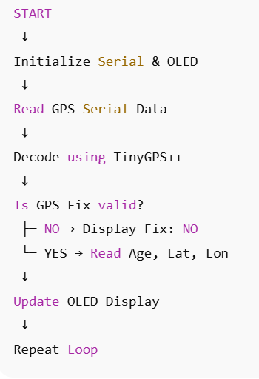
GPS Fix Quality and Accuracy
Flow of Operation

Slide 11
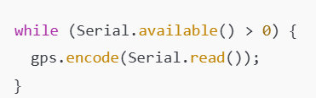
GPS Fix Quality and Accuracy
Code Explanation: GPS Data Decoding
GPS data is received as a continuous serial stream
TinyGPS++ processes and decodes NMEA sentences internally
Continuous decoding is required for reliable Fix detection

Slide 12


GPS Fix Quality and Accuracy
Code Explanation: Fix and Freshness Validation
Fix Validation
Determines whether a valid GPS Fix has been achieved
Prevents the use of invalid or incomplete positioning data
Data Freshness(Age)
Indicates how recent the GPS position data is
Lower values indicate fresher and more reliable data

Slide 13
GPS Fix Quality and Accuracy
OLED Output Interpretation
Displayed Parameters
Fix Indicates GPS lock status
Age Represents freshness of the location data
Latitude / Longitude Geographical position in degrees
Recommended Condition for Use
Fix = YES
Age less than a few seconds

Slide 14
GPS Fix Quality and Accuracy
Testing Procedure
Place the system outdoors with clear sky visibility
Power ON the GPS module
Allow sufficient time for cold start
Observe Fix transition from NO to YES
Monitor Age and coordinate stability
Record Fix time and Age values

Slide 15
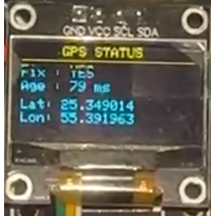
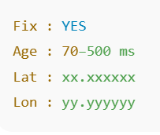
GPS Fix Quality and Accuracy
Result Interpretation
Expected Results
GPS Fix becomes valid after satellite lock
Age remains low during stable operation
Latitude and Longitude stabilize over time
OLED updates consistently
Typical Observation

Slide 16
GPS Fix Quality and Accuracy
Practical Considerations
Important Observations
Indoor operation often results in Fix = NO
Cold start requires patience and clear sky view
GPS must be treated as a state-based sensor
Validation is mandatory before navigation use
Summary
GPS Fix determines positional validity
Age indicates freshness of data
GPS reliability improves over time
Validation prevents navigation errors
This experiment establishes disciplined GPS usage

Slide 17
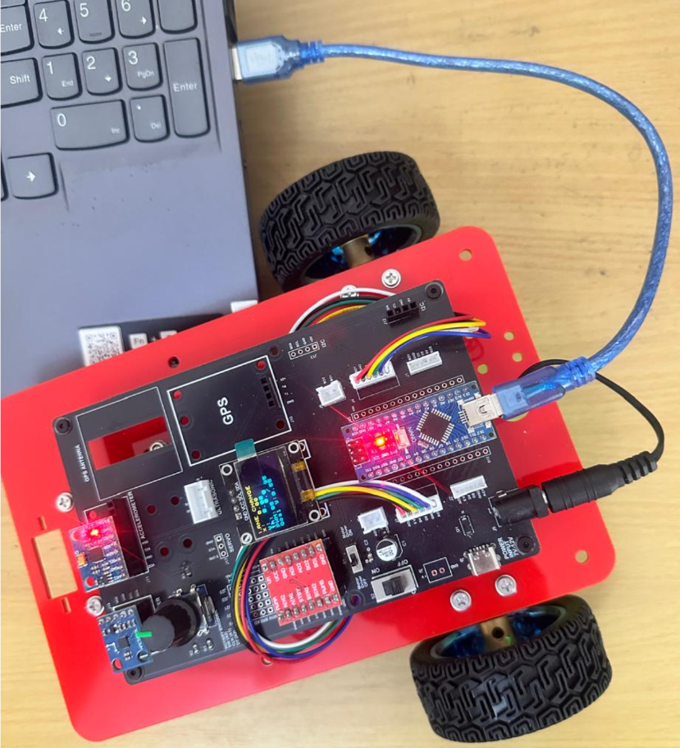
GPS Fix Quality and Accuracy
Critical Programming Setup
MANDATORY Switch Settings Before Uploading Code
Before connecting USB and uploading program:
“Motor Driver ON/OFF” Switch
⚠️ MUST BE SET TO: OFF
Why?
Prevents motors from running during code upload
Avoids car moving unexpectedly on desk
Protects USB connection from power surges

Slide 18
GPS Fix Quality and Accuracy
During Programming (Code Upload):
Step 1: Connect USB cable to computer
Step 2: Set Switch “Motor Driver ON/OFF” → OFF
Step 3: Set Switch “Battery ON/OFF ” → OFF ->for batter power
Step 4: Upload your the respective program
Step 5: Wait for "Upload Complete" message
Step 6: Disconnect USB cable
Before Testing (Running the Robot):
Step 1: Place robot on the ground. No obstacle as this test for basic movements
Step 2: Set Switch “Motor Driver ON/OFF” ->ON ( motor driver ON)
Step 3: Set Switch “Battery ON/OFF” → ON -> for batter power
Step 4: Monitor the Robot car-3 Movements & OLED , Monitior the functionality according to the program
https://github.com/info-zas/zas-robotics-car-3-encoders-imu-gps/tree/main/01_FoundationProjects/06_Car-3_GPS_Fix_Quality_and_Accuracy
Lesson Code – GitHub URL:

Slide 19
Q&A
Invite Questions: Encourage the audience to ask questions for further clarification or discussion.

